Slide 1
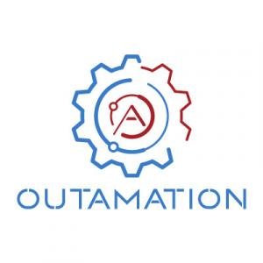

Open-Source RAG Pipeline
~ FAVOUR UMEJESI

Slide 2
Overview of RAG Pipeline
The Retrieval-Augmented Generation (RAG) pipeline combines search and generation to answer questions using external documents. Instead of relying only on an LLM’s memory, it first retrieves relevant information from a knowledge base (like PDFs or articles), then uses a language model to generate accurate, context-based answers.
What Problem Does It Solve?
LLMs can “hallucinate” or guess answers when they don’t have the right context. RAG solves this by:
Pulling facts from actual documents
Grounding responses in evidence
Handling large, evolving data sources without fine-tuning the model
It’s beneficial for tasks like document Q&A, legal/legal document analysis, customer support, and research.

Slide 3
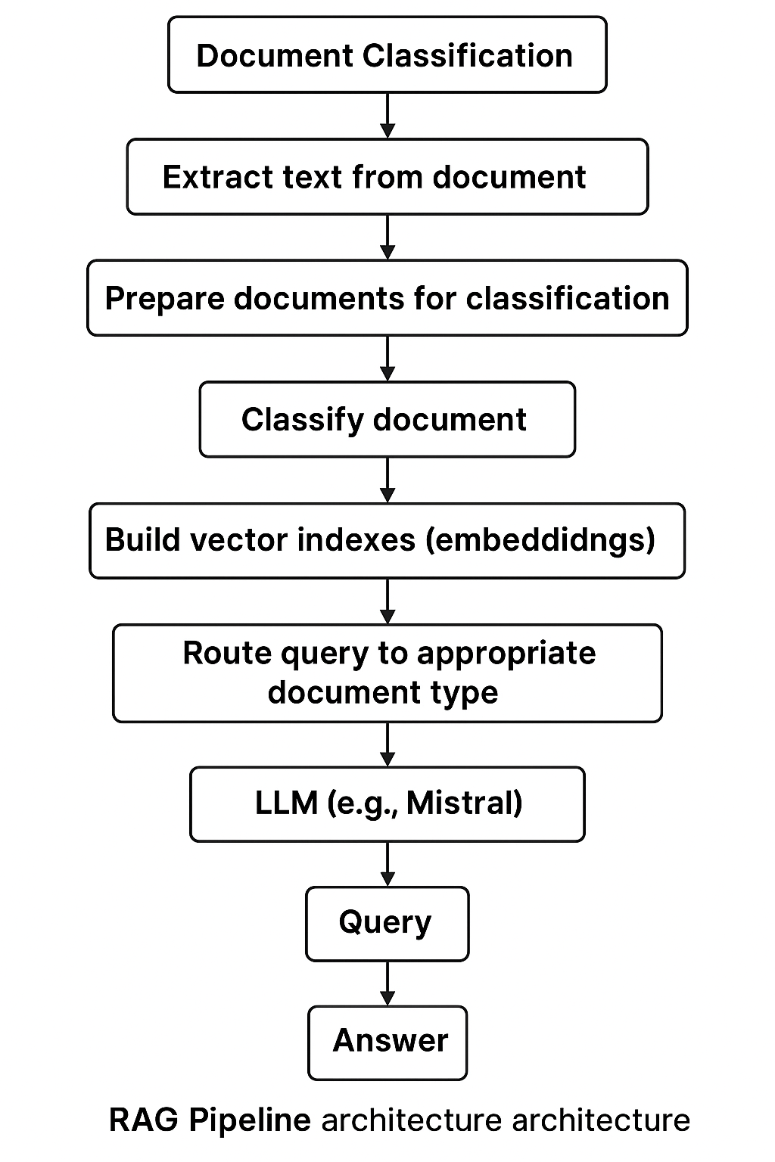
RAG Pipeline Architecture
RAG Pipeline Architecture Overview
This architecture outlines the step-by-step process of a Retrieval-Augmented Generation (RAG) system powered by Mistral. The pipeline begins with document classification and text extraction, followed by semantic indexing for each classified type. A query is routed to the correct document category using an LLM, and finally, Mistral generates a context-aware answer based on the most relevant information.

Slide 4
Experiments & Optimizations
Initial Challenge
No document classification
RAG pipeline generated answers not grounded in the right documents
Top 5 Improvements I Tried
Document Classification
What I Did: Categorized documents before retrieval
Why: Ensured queries were routed to the right document type
Result: Improved retrieval precision and answer accuracy
Semantic Chunking
What I Did: Used meaningful sections like headers & key phrases instead of fixed-length chunks
Why: Maintained context and improved retrieval quality
Result: Answers were more relevant and context-aware
Optimized Embeddings
What I Did: Switched to BAAI/bge-small-en-v1.5 from HuggingFace
Why: Faster and more accurate than the default model
Result: Better text representation and ranking

Slide 5
(Continuation of Experiments & Improvements)
LLM Optimization – Mistral Integration
What I Did: Replaced generic LLM with Mistral via LlamaCPP
Why: Lightweight, efficient, and accurate
Result: Faster response times with high-quality generation
Dynamic Query Routing
What I Did: Classified queries before retrieval
Why: Prevented irrelevant document searches
Result: More targeted, efficient RAG pipeline

Slide 6
What Worked & What Did not?
What Didn’t Work
Hybrid Retrieval (BM25 + Vector Search) ~ Known for accuracy in financial/legal use cases ~ But returned LLM-generated responses not grounded in the actual documents
No Document Classification ~ Queries weren’t properly routed ~ Resulted in irrelevant or vague answers
Semantic Chunking (Alone) ~ Maintained context ~ But increased retrieval time and reduced efficiency
What Worked
Weighted Retrieval Method ✔ Prioritized high-confidence document chunks ✔ Resulted in more accurate, context-grounded answers
Query Routing with Mistral (via LlamaCPP) ✔ Replaced generic LLM with a faster, optimized model ✔ Enabled precise query-to-category matching

Slide 7
Lessons Learned & Next Steps
Lessons Learned
The importance of document classification Essential when working with multiple document types to ensure accurate query responses
Hands-on experience with open-source LLMs First time working with models like Mistral, after previously using closed-source tools
Next Steps
Experiment with faster embedding models ~ e.g., E5-small-v2 to reduce retrieval latency
Integrate a RAG pipeline into a software project ~ As a software development enthusiast passionate about AI/ML, I am excited to build a real-world app that leverages RAG for document understanding.

